Slide 1
Northwest Market

Slide 2

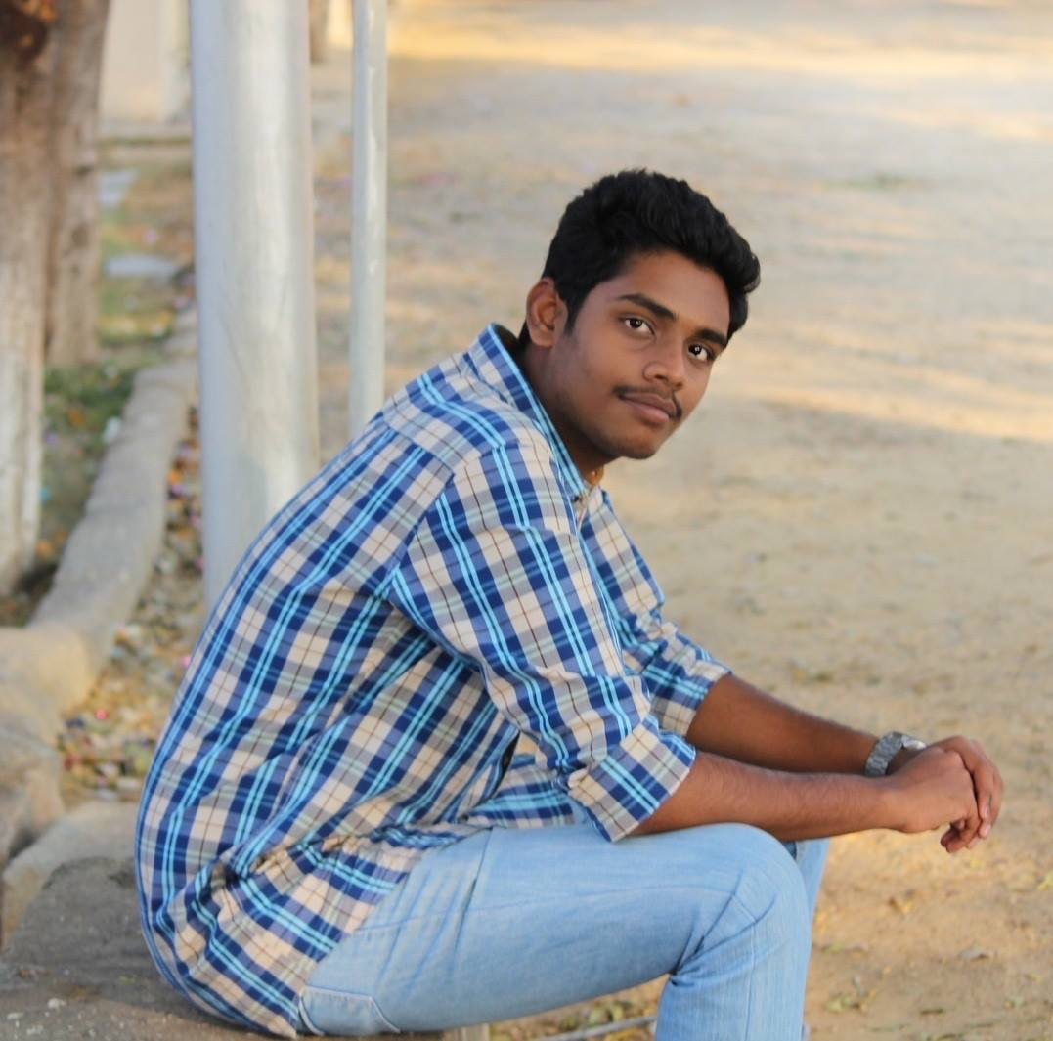
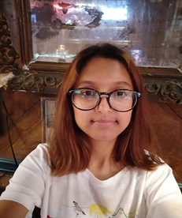
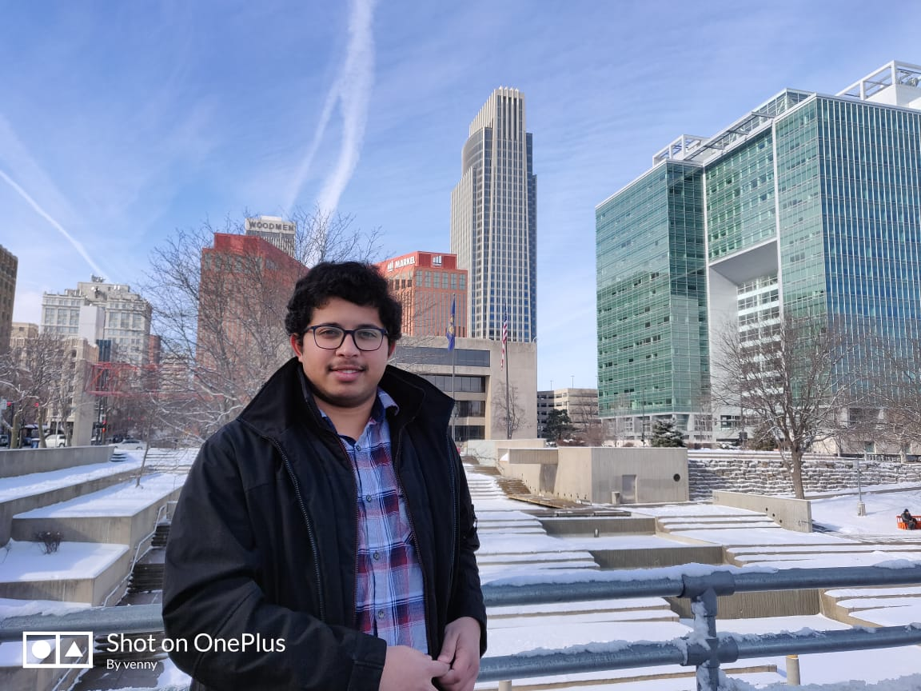
Team 3
Sandeep Devineni
Vamshi Krishna
Yaswanth Yarram
Binita Singh

Slide 3
Problem
The University students do not have a right platform for the e-commerce of the used products.
Binita singh

Slide 4

Solution
An e-commerce application only for the university students where they can sell their used products of six different categories like clothing,electronics,footwear,books,sports and automobile.
The user can also buy the different products.

Slide 5
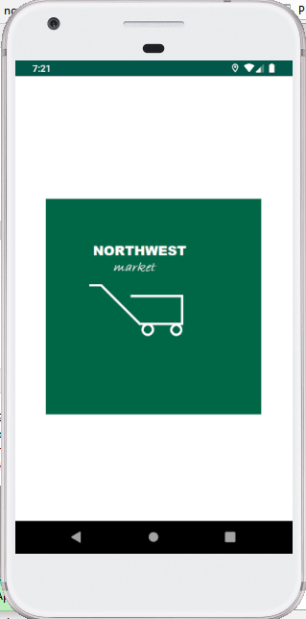
Splash Screen
This screen displays our app logo for 3 seconds before entering into the application.

Slide 6
Registration
Registration screen can be used by the novice user for registering into the application.
In this screen, the user needs to enter the username, contact number, e-mail, password and confirm the password for registration.
Binita singh

Slide 7
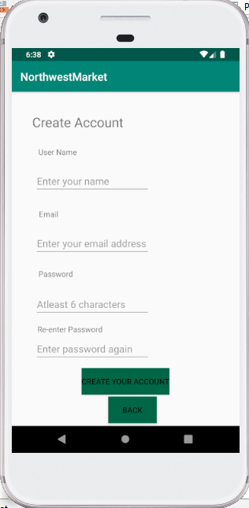
Registration screen
Binita singh

Slide 8
Email Authentication
User will get a verification link to their email. Before logging in to the application he/she must be verified through that link.
Binita singh

Slide 9
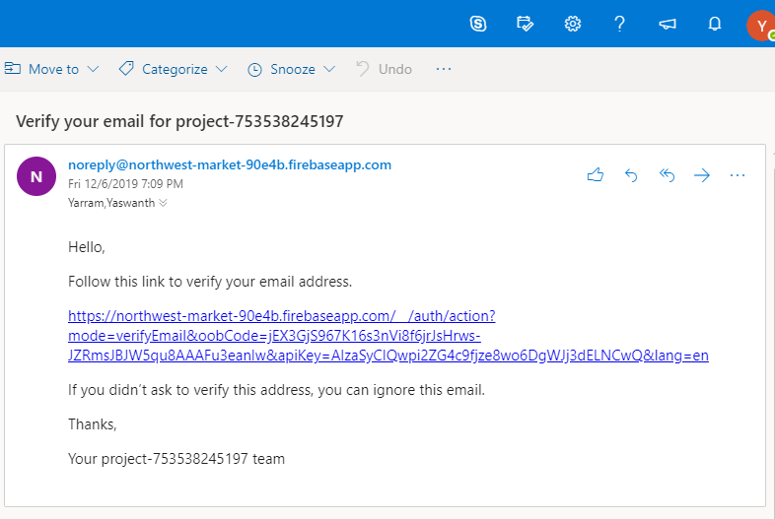
Email Authentication screen
Binita singh

Slide 10
Login
Login screen can be used by the registered user for logging into the application.
In this screen, the user must enter the username and password to get into the application.
This screen has a “Forgot Password” feature which leads the user to reset their password.
Vamsi krishna

Slide 11
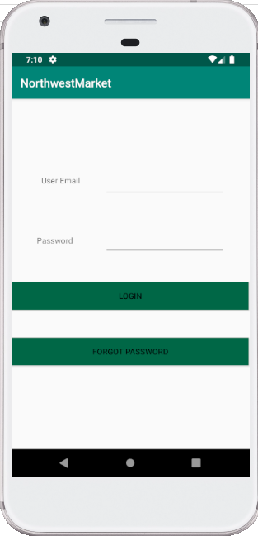
Login screen
Vamsi krishna

Slide 12
Forgot Password
Users can use forgot password if they forget their password.
Users can enter their registered email in the page and an email will be sent to the user through which they can reset their password.
Vamsi krishna

Slide 13
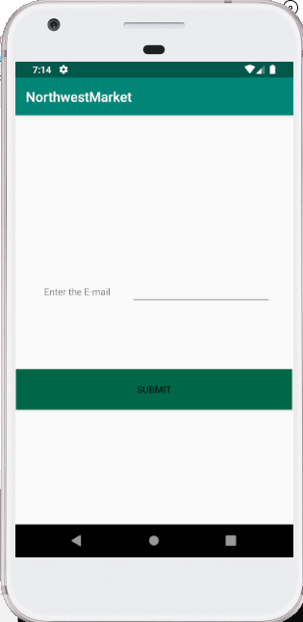
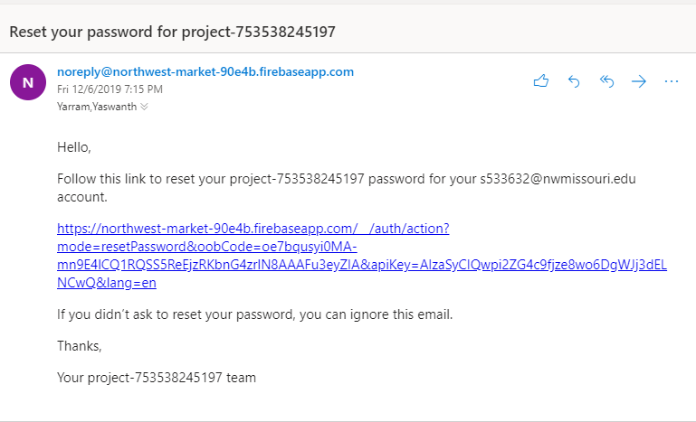
Forgot Password screen

Slide 14
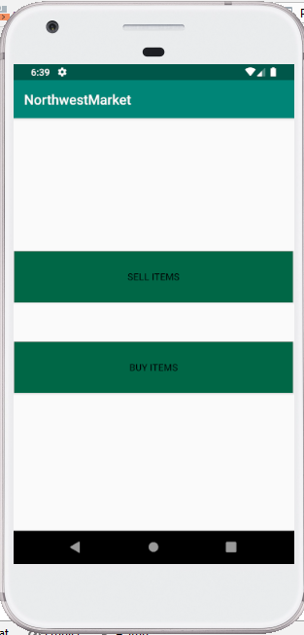
Home page
Vamsi Krishna

Slide 15
Add Product
User can add product by filling all the details related to product like product id, product name, product description, product category, product cost, product image and contact details.
Vamsi krishna

Slide 16
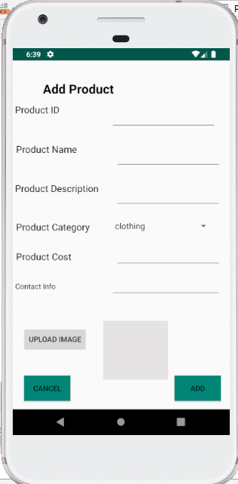
Add Product screen
Vamsi krishna

Slide 17
Menu
menu has navigation to different categories like clothing, footwear, sports, books, electronics and automobile.
Sandeep

Slide 18
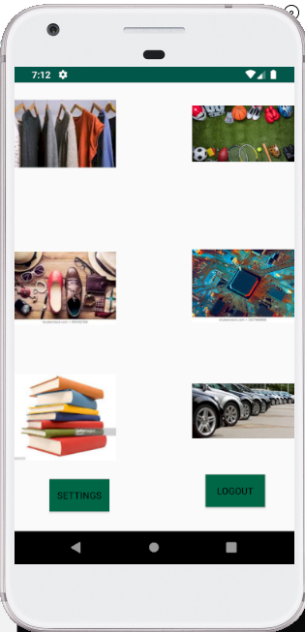
Menu screen
Sandeep

Slide 19
Product Details
When a user click on a particular product he/she can view the product details like cost, image, product description and seller’s contact details.
sandeep

Slide 20
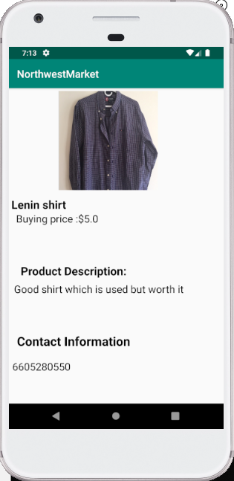
Product Details screen

Slide 21
User Settings
User can change the password and update it immediately.
Sandeep

Slide 22
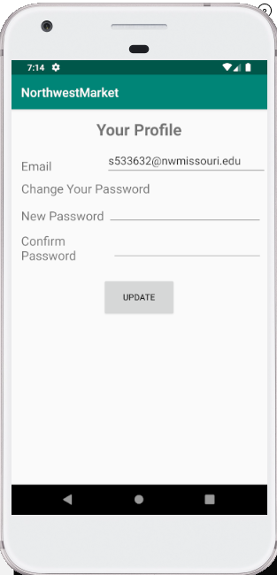
User Settings screen
Sandeep

Slide 23
Database
We are using firebase as our database where we are storing the users emails, passwords, products and product details.
Sandeep

Slide 24
DEMO
Yaswanth

Slide 25
Summary
This is an e-commerce application for the university students where they can sell and buy the used products.
Yaswanth

Slide 26


